Slide 1

Introduction to Data Science and Systems
Lecture 1:Vectors and Matrices
Dr Nicolas Pugeault

Slide 2
Intended Learning Outcomes
what a vector is and a what a vector space is
the standard operations on vectors: addition and multiplication
what a norm is and how it can be used to measure vectors
what an inner product is and how it gives rise to geometry of vectors
how mathematical vectors map onto numerical arrays
the different p-norms and their uses
important computational uses of vector representations
how to characterise vector data with a mean vector and a covariance matrix
the properties of high-dimensional vector spaces
the basic notation for matrices
the view of matrices as linear maps
how basic geometric transforms are implemented using matrices
how matrix multiplication is defined and its algebraic properties
the basic anatomy of matrices
Notes:
By the end of this unit you should know:

Slide 3

Example: Text and translation
Text, as represented by strings in memory, has weak structure.
There are comparison functions for strings (e.g. edit distance, Hamming distance), but only character-level semantics
String operations are character-level operations like concatenation or reversal, but not useful for machine translation system

Slide 4
Words aren't enough
Original
"The craft held fast to the bank of the burn."
(the vessel stayed moored to the edge of the stream)
Dictionary lookup (naiive)
French: "L'artisanat tenu rapide à la Banque de la brûlure."
(the artisanal skill held quickly to the financial institution of the burn wounds)
Danish: "Håndværket holdt fast til banken af brænden"
(The craftmanship held fast to the bank [financial institution] of fire)
Correct(ish)
French: "Le bateau se tenait fermement à la rive du ruisseau."
(the boat was firmly attached to the riverbank)
Danish: "Farttøjet holdt fast i bredden af åen"
(The vessel held fast at the bank of the river)
Notes:
Words aren‘t enough
Looking up words in the dictionary doesn't work as translation model, no matter how brilliant your text comparison algorithms are:

Slide 5
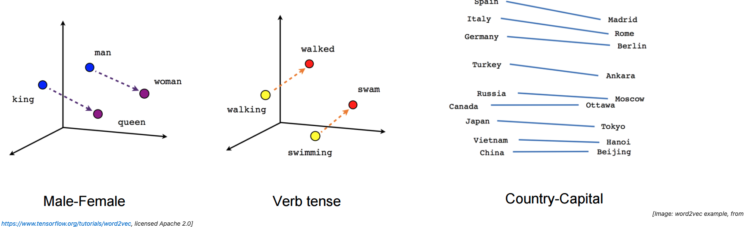
Solution -- to place them in a vector space
Imbue text fragments with additional mathematical structure -- to place them in a vector space
Fragments might be words, partial words or whole sentences
Notes:
An effective approach is to imbue text fragments with additional mathematical structure -- to place them in a vector space.
This is called embedding and algorithms such as Word2vec can learn a transformation from strings to high dimensional vectors (typically >100D) simply by observing large amounts of text.

Slide 6
The structure of a (topological) vector space
What words are like salamander?
Distance/metric functions: norm
E.g. the neighbourhood of the vector corresponding to salamander, which might include words like axolotl or waterdog
What is the equivalent of a king, but with a woman instead of a man?
Operation functions: subtraction, mean
Famously, the original word2vec paper should that on their test data, the equation
King − Man + Woman = Queen
Notes:
Because this data has the structure of a (topological) vector space, it is possible answer computationally questions like:
Although each dimension of the space has no obvious meaning, the embedding means that semantics are mapped onto spatial relations.

Slide 7


Vector spaces
Vectors to be ordered tuples of real numbers
A vector has a fixed dimension n
Each element of the vector as representing a distance in a direction orthogonal to all the other elements.
Orthogonal just means "independent", or, geometrically speaking "at 90 degrees".
We write vectors with a bold lower case letter:

Slide 8
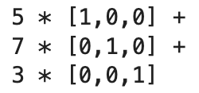
Vector spaces
For example, a length-3 vector might be used to represent a spatial position in Cartesian coordinates, with three orthogonal measurements for each vector.
Consider the 3D vector [5, 7, 3]
Each of these vectors [1,0,0], [0,1,0], [0,0,1] is pointing in a independent direction (orthogonal direction) and has length one.

Slide 9
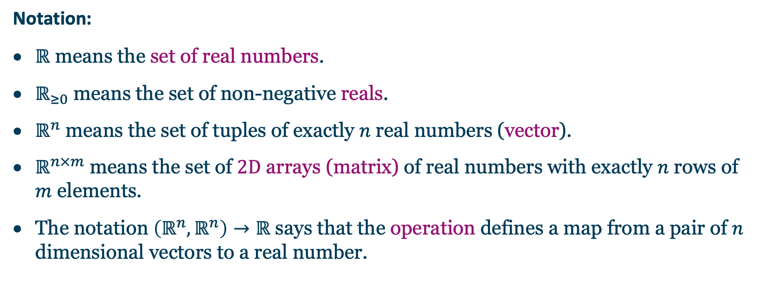
Points in space
Notation:
$ℝ$ means the set of real numbers.
$ℝ_{≥0}$ means the set of non-negative reals.
$ℝ^{n}$ means the set of tuples of exactly $n$ real numbers (vector).
$ℝ^{n×m}$ means the set of $2D$ arrays (matrix) of real numbers with exactly $n$ rows of $m$ elements.
The notation $\left(ℝ^{n},ℝ^{n}\right)→ℝ$ says that the operation defines a map from a pair of $n$ dimensional vectors to a real number.

Slide 10
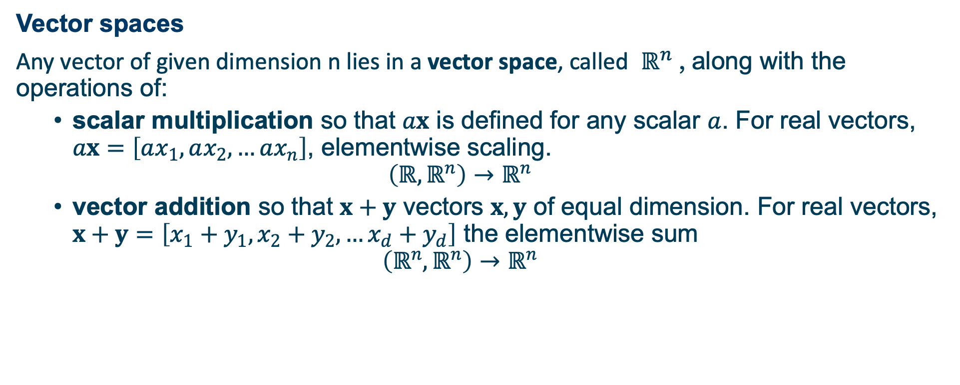
Points in space
Vector spaces
Any vector of given dimension n lies in a vector space, called $ℝ^{n}$ , along with the operations of:
scalar multiplication so that $ax$ is defined for any scalar $a$. For real vectors, $ax=\left[ax_{1},ax_{2},…ax_{n}\right]$, elementwise scaling.
$$\left(ℝ,ℝ^{n}\right)→ℝ^{n}$$
vector addition so that $x+y$ vectors $x,y$ of equal dimension. For real vectors, $x+y=\left[x_{1}+y_{1},x_{2}+y_{2},…x_{d}+y_{d}\right]$ the elementwise sum
$$\left(ℝ^{n},ℝ^{n}\right)→ℝ^{n}$$

Slide 11
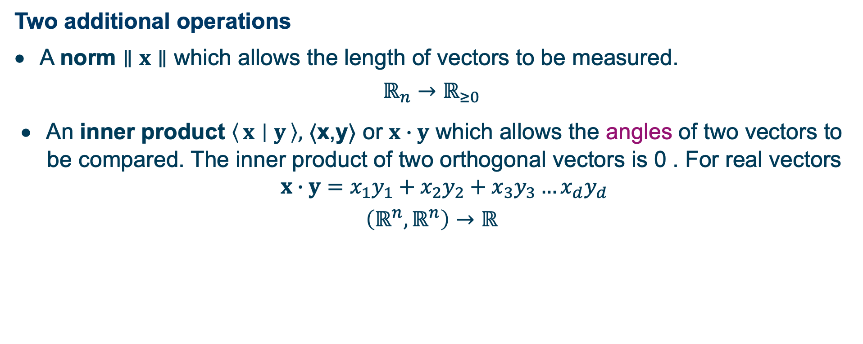
Points in space
Two additional operations
A norm $∥x∥$ which allows the length of vectors to be measured.
$$ℝ_{n}→ℝ_{≥0}$$
An inner product $\left\langle x ∣ y\right\rangle ,$ ⟨x,y⟩ ​or $x∙y$ which allows the angles of two vectors to be compared. The inner product of two orthogonal vectors is 0 . For real vectors $x∙y=x_{1}y_{1}+x_{2}y_{2}+x_{3}y_{3}…x_{d}y_{d}$
$$\left(ℝ^{n},ℝ^{n}\right)→ℝ$$
Notes:
All operations between vectors are defined within a vector space. We cannot, for example, add two vectors of different dimension, as they are elements of different spaces.
The symbol "⟨" is called "angle bracket" or "left angle bracket".

Slide 12
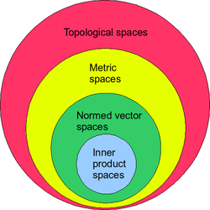
Topological and inner product spaces
With a norm a vector space is a normed vector space/topological vector space.
With an inner product, a vector space is an inner product space, and we can talk about the angle between two vectors.
Topological/geometrical space:
a set whose elements are called points
Metric space:
define distance between points, e.g. norm
Normed vector space:
a vector space with norm defined
Vector space
Notes:
In mathematics, a topological space is, roughly speaking, a geometrical space in which closeness is defined but cannot necessarily be measured by a numeric distance.
In mathematics, a metric space is a set together with a notion of distance between its elements, usually called points.
In mathematics, a normed vector space or normed space is a vector space over the real or complex numbers on which a norm is defined.

Slide 13
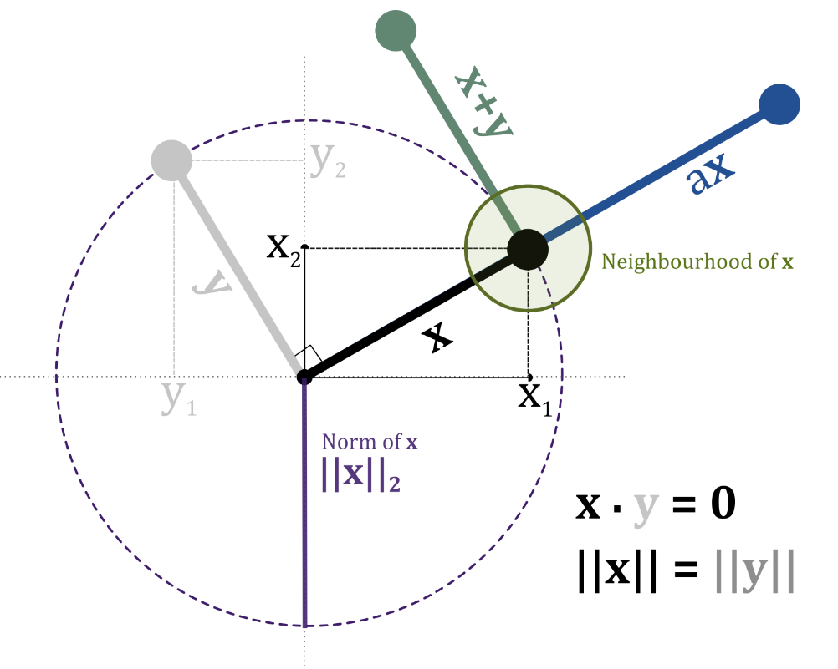
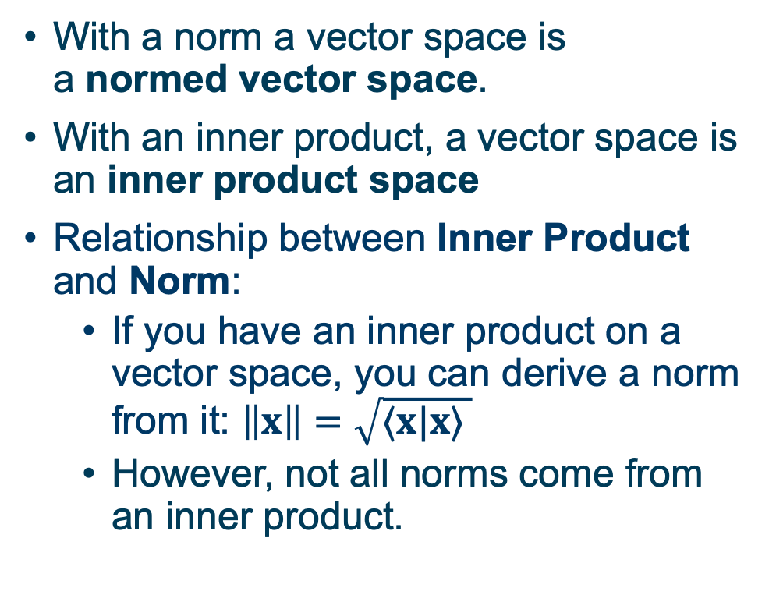
Topological and inner product spaces
With a norm a vector space is a normed vector space.
With an inner product, a vector space is an inner product space
Relationship between Inner Product and Norm:
If you have an inner product on a vector space, you can derive a norm from it: $\left\|x\right\|=\sqrt{⟨x|x⟩ }$
However, not all norms come from an inner product.
Notes:
you can define the norm of a vector to be the square root of the inner product of the vector with itself.
L2 Norm is the distance to the original point

Slide 14
Vectors
Points in space
Arrows pointing from the origin
Tuples of numbers
These are all valid ways of thinking about vectors.
The "points in space" mental model is probably the most useful
vectors to represent data; data lies in space
matrices to represent operations on data; matrices warp space.

Slide 15
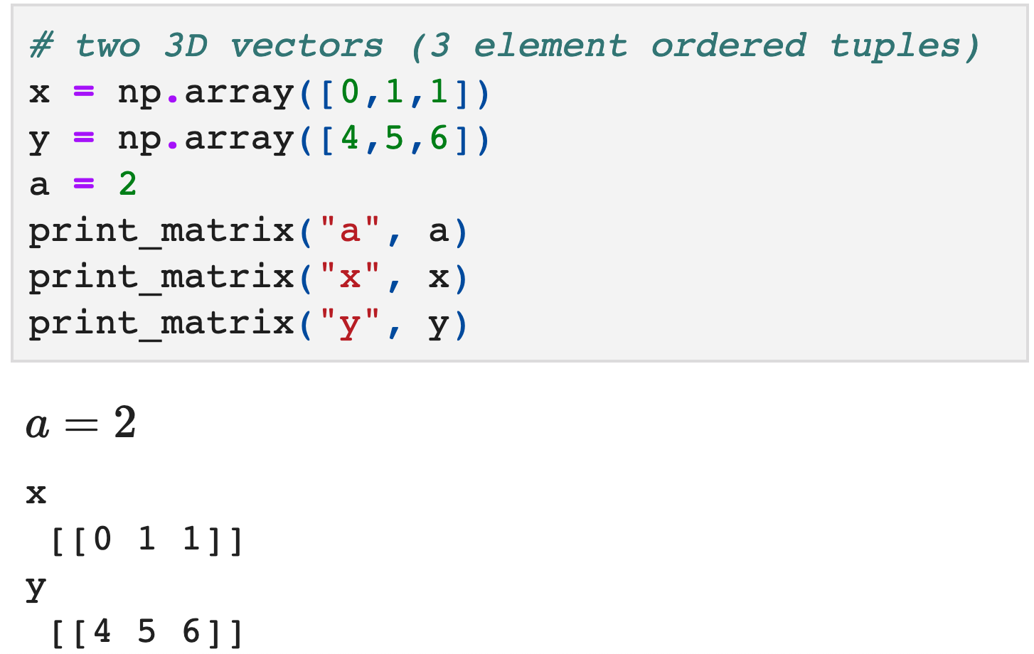
Relation to arrays
1D floating point arrays are
we called "vectors"
floating point numbers
are NOT real numbers
Notes:
These vectors of real numbers can be represented by the 1D floating point arrays we called "vectors" in the self-study. But be careful; the representation and the mathematical element are different things, just as floating point numbers are not real numbers.

Slide 16
Uses of vectors
They are a lingua franca for data. Because vectors can be
composed (via addition),
compared (via norms/inner products)
and weighted (by scaling),
In Numpy, they map onto the efficient ndarray data structure, so we can operate on them efficiently and concisely.

Slide 17
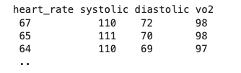

Vector data
Datasets are commonly stored as 2D tables.
Observations
one element of the vector (feature)
Each row can be seen as a vector in $ℝ^{n}$

Slide 18
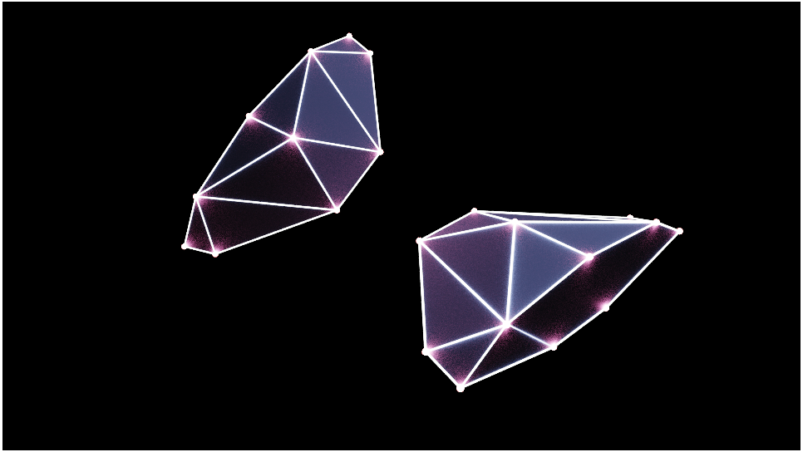
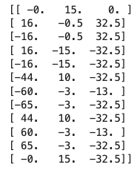
Geometric operations
Use vectors in 3D space
Transformations in 3D space include:
scaling
rotation
flipping (mirroring)
translation (shifting)
The Cobra Mk. III spaceship model above is defined by these vectors specifying the vertices in 3D space

Slide 19
Machine learning applications
Machine learning relies heavily on vector representation. A typical machine learning process involves:
transforming some data onto feature vectors
creating a function that transforms feature vectors to a prediction (e.g. a class label)
Most machine learning algorithms can be seen as doing geometric operations: comparing distances, warping space, computing angles, and so on.
E.g. k nearest neighbours

Slide 20
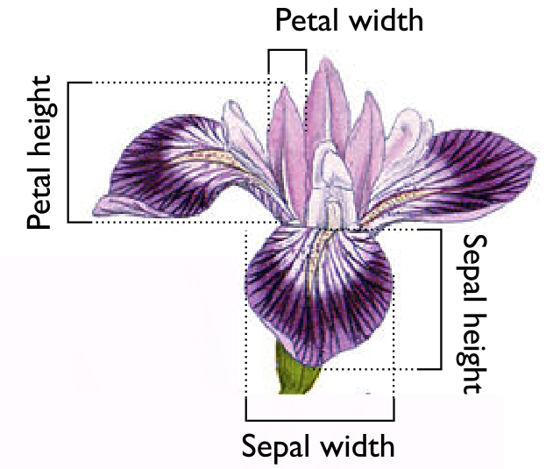
Example: irises classification
The irises classification task:
The measurements of the dimensions of the sepals and petals of irises allows classification of species
Training data: [sepal height, petal]
Labels: species of irises
k nearest neighbours
Using a norm to compute distances
The output prediction is the class label that occurs most times among these k neighbours

Slide 21
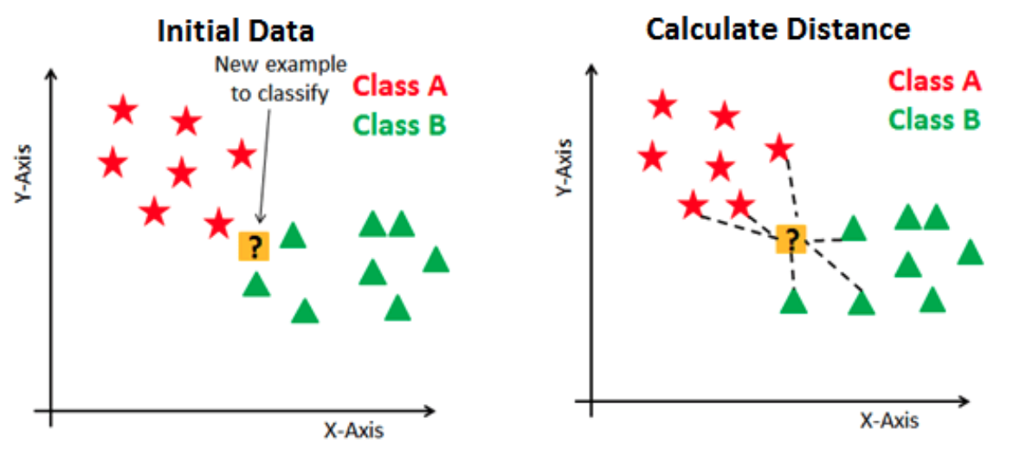
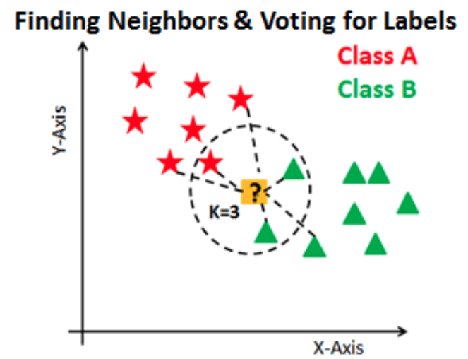
Example: irises classification
k nearest neighbours
Calculate distance between training examples and the target using norm
Finding the closest k neighbors (e.g. 3, 5, 10), voting for the most majority
Notes:
Image: pairplot of the four dimensions of the iris dataset against each other. A new point (yellow) is tested, and the 3 nearest neighbours (black dashed circles) are shown. The result of classification is the majority label of the neighbours; here, most of the neighbours belong to the green class

Slide 22
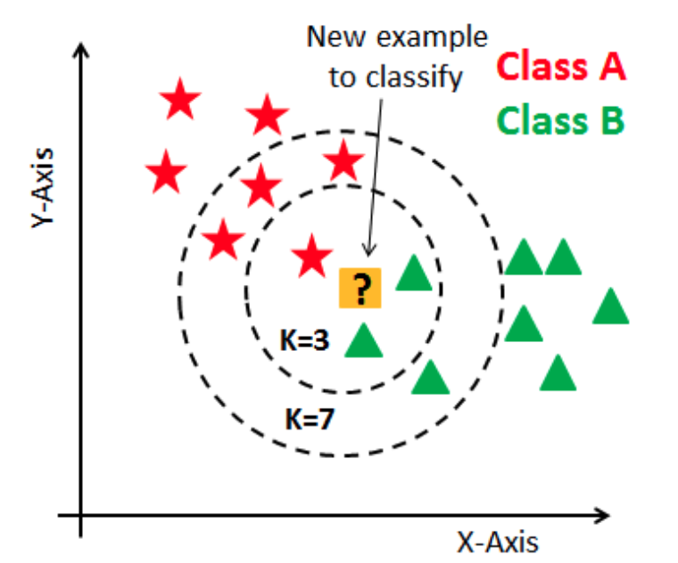
Example: irises classification
The choice of k might significantly affect the prediction result
The distance function (norm or cosine similarity) is something need to be considered
Notes:
Image: pairplot of the four dimensions of the iris dataset against each other. A new point (yellow) is tested, and the 3 nearest neighbours (black dashed circles) are shown. The result of classification is the majority label of the neighbours; here, most of the neighbours belong to the green class

Slide 23
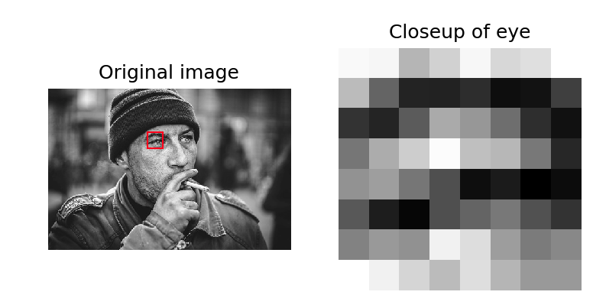
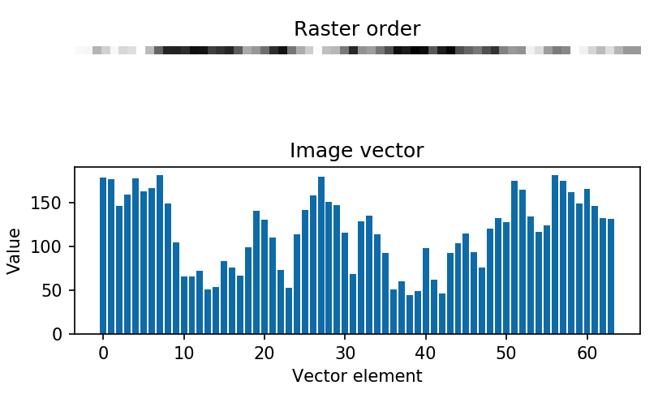
Example: Image compression
Images can be represented as 2D arrays of brightness
Groups of pixels -- for example, rectangular patches -- can be unraveled into a vector.
E.g. An 8x8 image patch would be unraveled to a 64-dimensional vector.
Splitting images into patches, and treating each patch as a vector x_1,…,x_n
The vectors are clustered to find a small number of vectors y_1,…,y_m, m<<n that are a reasonable approximation of nearby vectors.
the vectors for the small number of representative vectors y_i are stored (the codebook)

Slide 24
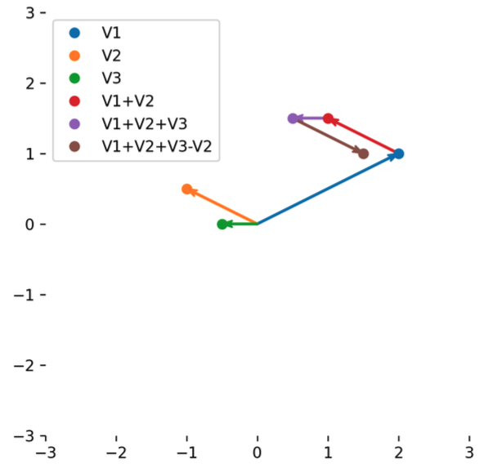

Basic vector operations
Standard operations:
getting the length of vectors (norm)
computing dot (inner), outer and cross products.
Addition and multiplication -- form weighted sums of vectors
See the lecture note for codes

Slide 25
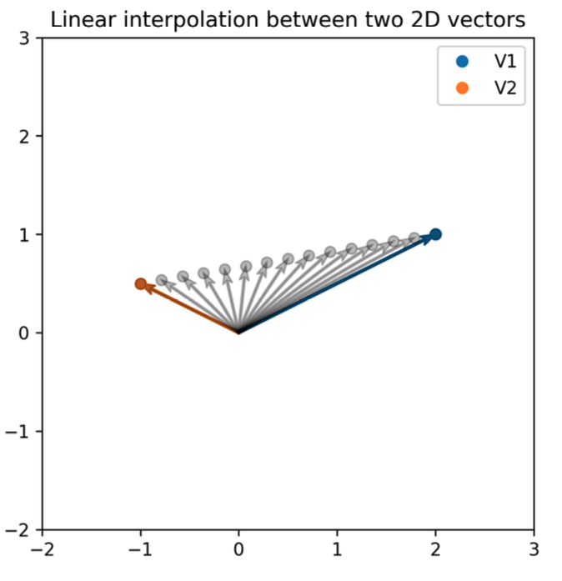

Basic vector operations
Many standard statistics and operations can be directly applied.
Linear interpolation: to construct new data points within the range of known data points.
See the lecture note for codes
Notes:
This lets us move along the line between two vectors: as α� goes from 0 to 1, the result goes in a smooth straight line from x� to y�.

Slide 26
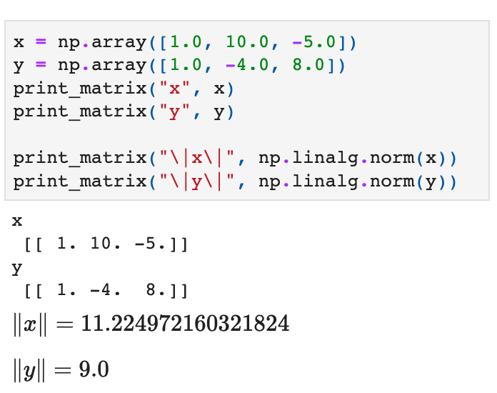

How big is that vector?
The Euclidean length of a vector x (written as ||x||) can be computed directly using np.linalg.norm().
This is equal to:

Slide 27
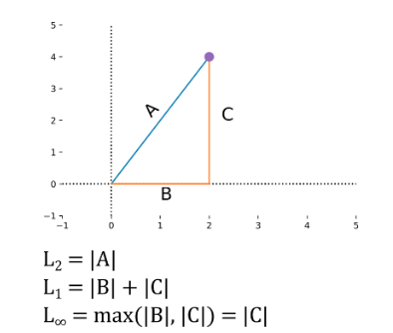

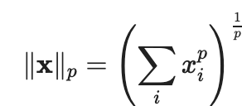

Different norms
Euclidean norm or Euclidean distance measure
$L_{\text{p}}$-norms or Minkowski norms, which is defined by:

Slide 28
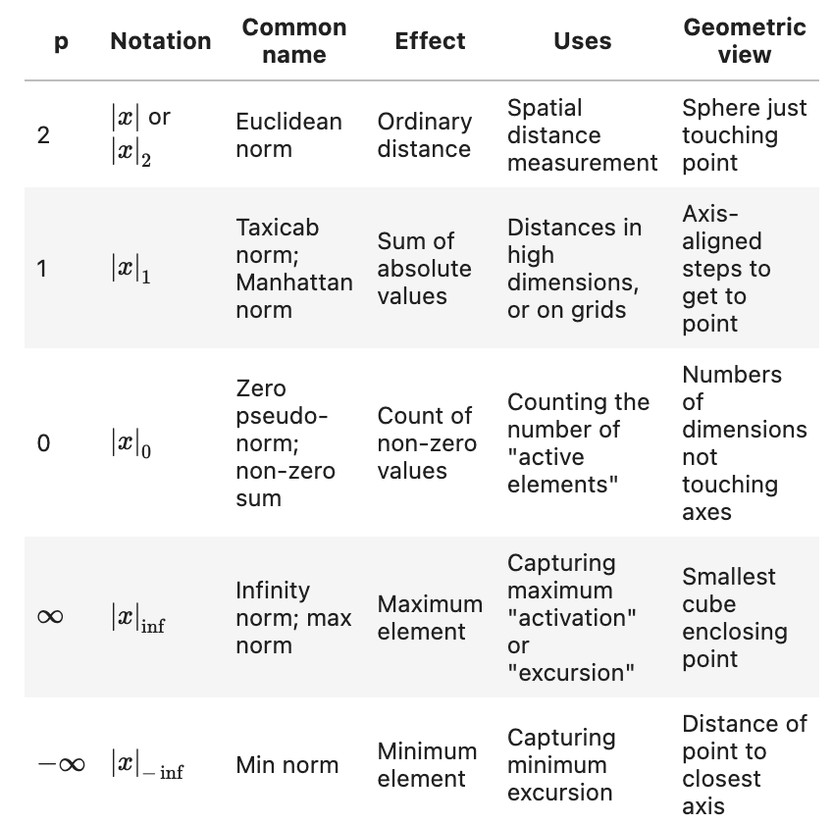
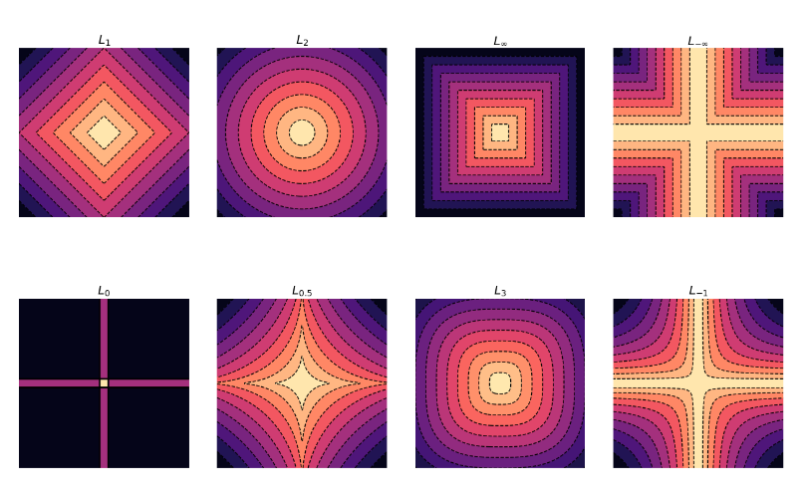
Different norms
Every dashed line has the same distance to the origin as measured in that norm. The points of equal distance in that norm appear as a connected line.

Slide 29
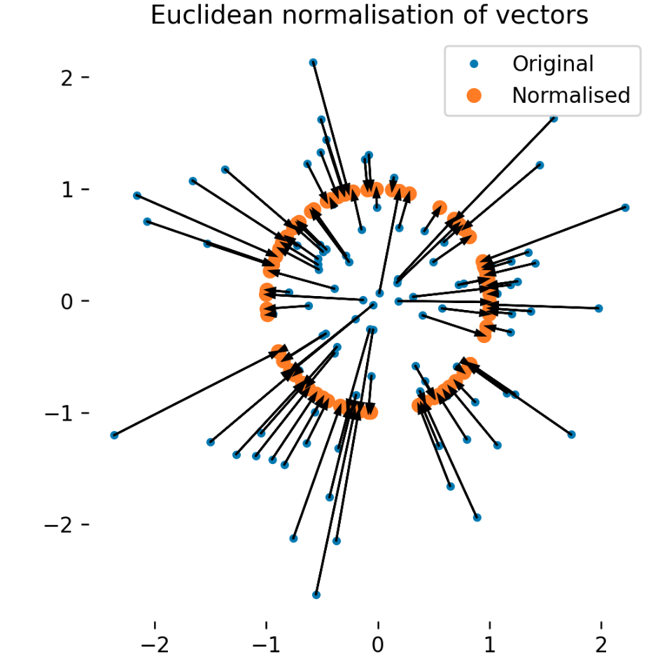
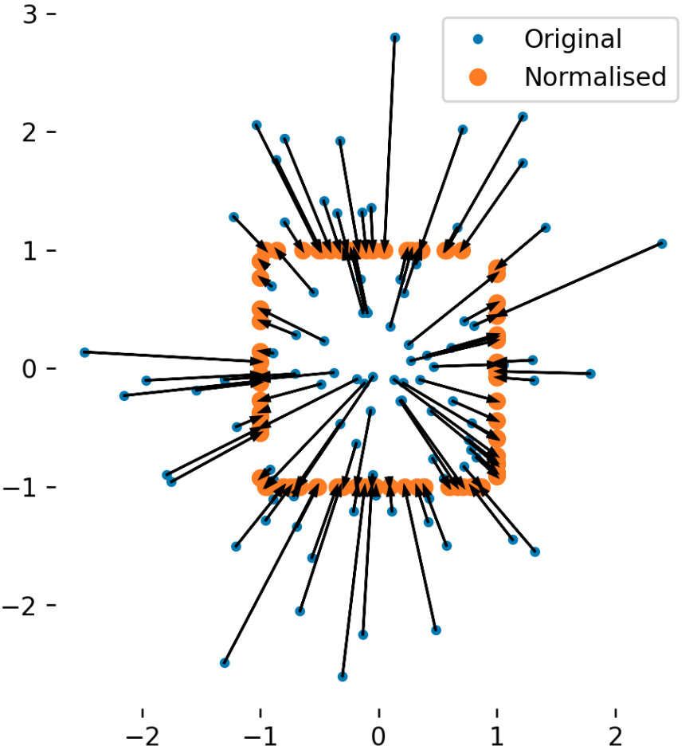
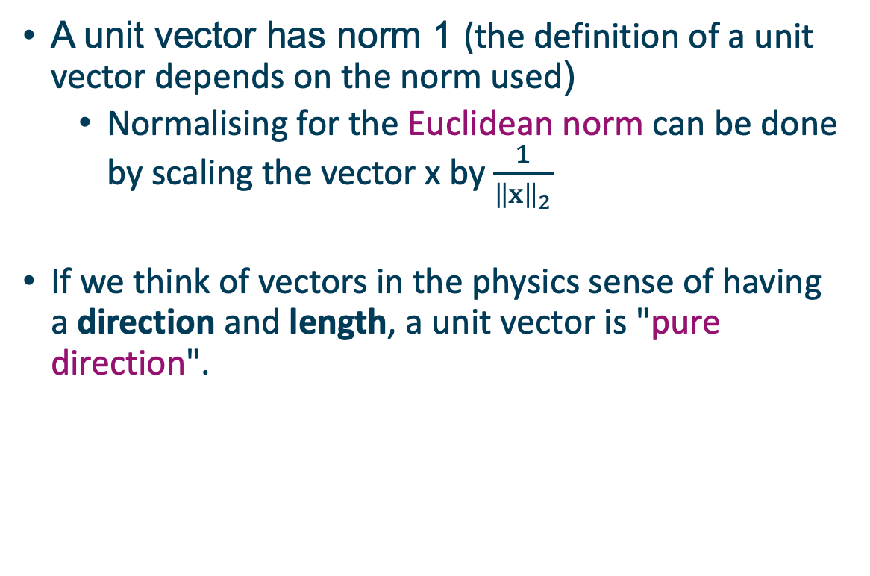
Unit vectors and normalisation
A unit vector has norm 1 (the definition of a unit vector depends on the norm used)
Normalising for the Euclidean norm can be done by scaling the vector x by $\frac{1}{{\left\|x\right\|}_{2}}$
If we think of vectors in the physics sense of having a direction and length, a unit vector is "pure direction".

Slide 30
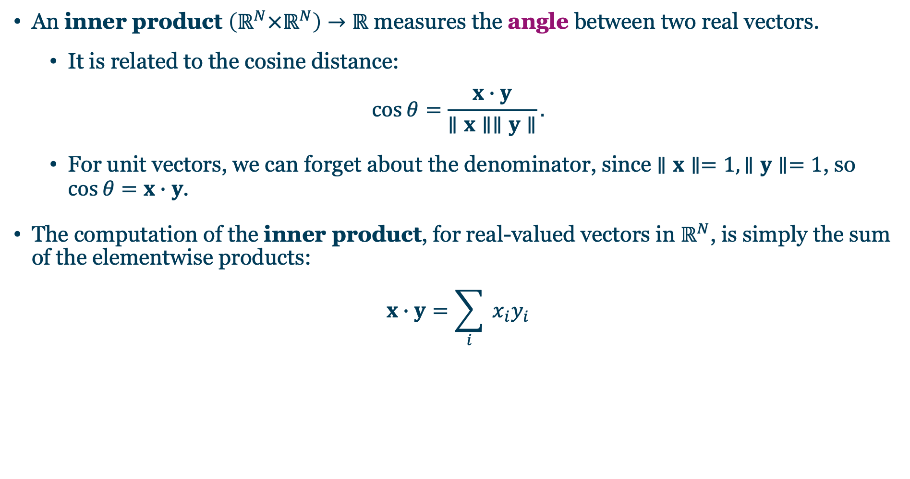
Inner products of vectors
An inner product $\left(ℝ^{N}×ℝ^{N}\right)→ℝ$ measures the angle between two real vectors.
It is related to the cosine distance:
$$cos⁡θ=\frac{x∙y}{∥x∥∥y∥}.$$
For unit vectors, we can forget about the denominator, since $∥x∥=1,∥y∥=1$, so $cos⁡θ=x∙y$.
The computation of the inner product, for real-valued vectors in $ℝ^{N}$, is simply the sum of the elementwise products:
$$x∙y=\sum_{i}{ }x_{i}y_{i}$$

Slide 31
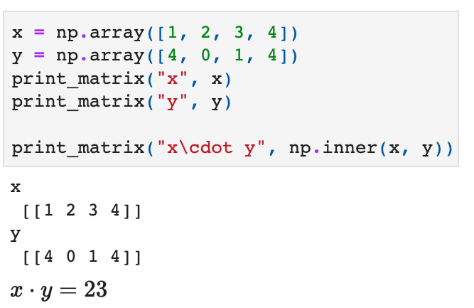
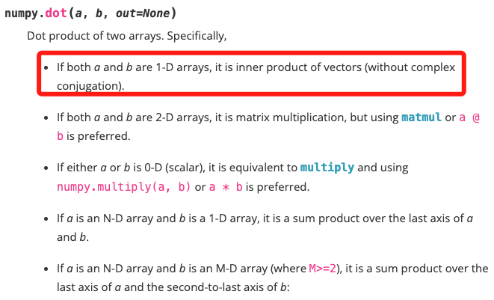
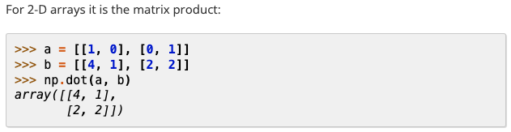
Inner products of vectors
Inner product in Numpy
The inner product is only defined between vectors of the same dimension, and only in inner product spaces. - ValueError
Don’t mix it with the dot product

Slide 32
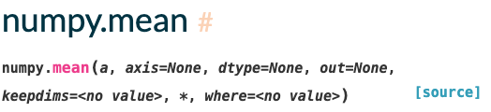
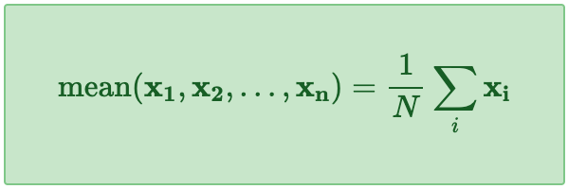
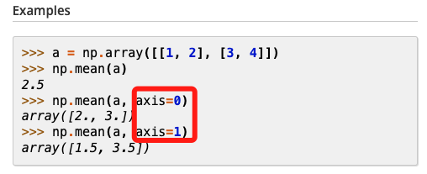
Basic vector statistics
Some statistics that generalise the statistics of ordinary real numbers
mean vector of a collection of N vectors
The mean vector is the geometric centroid of a set of vectors and can be thought of as capturing "centre of mass" of those vectors.
axis=0 for the purpose of mean vector
Notes:
We can center a dataset stored as an array of vectors to zero mean by just subtracting the mean vector from every row.

Slide 33
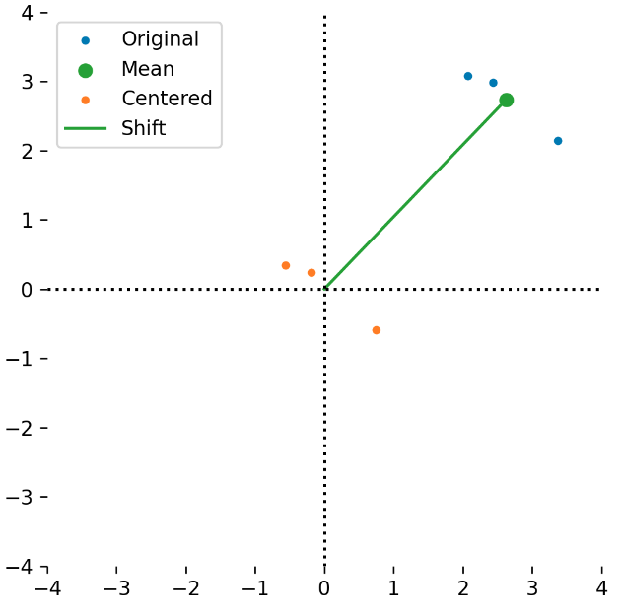
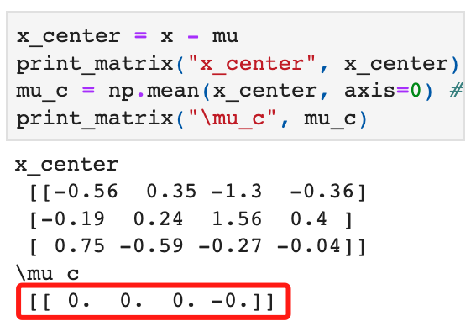
Center a dataset
We can center a dataset stored as an array of vectors to zero mean by just subtracting the mean vector from every row.

Slide 34
High-dimensional vector spaces
Data science often involves high dimensional vector spaces
High-dimensional can mean any d>3;
a 20-dimensional feature set might be called medium-dimensional;
a 1000-dimensional might be called high-dimensional;
a 1M-dimensional dataset might be called extremely high-dimensional
Curse of dimensionality: Many algorithms that work really well in low dimensions break down in higher dimensions.
Notes:
Vectors in low dimensional space, such as 2D and 3D are familiar in their operation. However, data science often involves high dimensional vector spaces, which obey the same mathematical rules as we have defined, but whose properties are sometimes unintuitive.

Slide 35

Example: sailing weather station
Task: to measure local atmospheric conditions during voyages
Input: wind speed, temperature, humidity, sunshine hours, etc., over 10,000 measurements
Output: is it likely to be above 30C tomorrow?

Slide 36
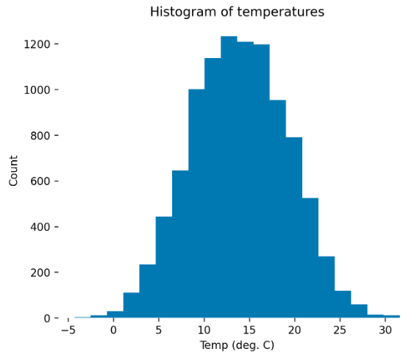
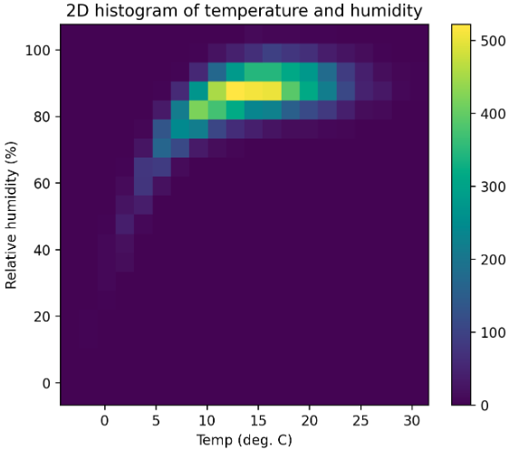
Example: sailing weather station
Temperature (1D)
Temperature & Humidity (3D)
Now there are 20 bins in total for this dimension
Now there are 20 bins in each dimension, for 400 bins total.

Slide 37
Example: sailing weather station
If we had 10 different measurements (air temperature, air humidity, latitude, longitude, wind speed, wind direction, precipitation, time of day, solar power, sea temperature)
we wanted to subdivide them into 20 bins each
How many bins in total?

Slide 38
Example: sailing weather station
If we had 10 different measurements (air temperature, air humidity, latitude, longitude, wind speed, wind direction, precipitation, time of day, solar power, sea temperature)
We wanted to subdivide them into 20 bins each
How many bins in total?
even using 8 bit unsigned integers this would be 10TB of memory
But we only have 10,000 measurements
We would need a histogram with 20^10 bins -- over 10 trillion bins.

Slide 39
Example: sailing weather station
If we had 10 different measurements (air temperature, air humidity, latitude, longitude, wind speed, wind direction, precipitation, time of day, solar power, sea temperature)
We wanted to subdivide them into 20 bins each
How many bins in total?
even using 8 bit unsigned integers this would be 10TB of memory
But we only have 10,000 measurements
We would need a histogram with 20^10 bins -- over 10 trillion bins.
Curse of dimensionality: as dimension increases generalisation gets harder exponentially

Slide 40
Matrices and linear operators
Matrices are 2D arrays of reals that define linear maps;
Vectors represent “points in space"
Matrices represent operations that do things to those points in space.
The operations represented by matrices are a particular class of functions on vectors
Notes:
We have seen that (real) vectors represent elements of a vector space as 1D arrays of real numbers (and implemented as ndarrays of floats).

Slide 41
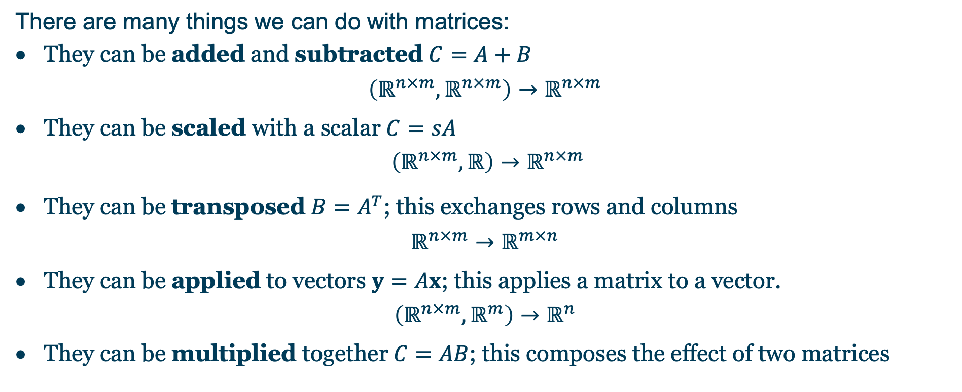
Operations with matrices
There are many things we can do with matrices:
They can be added and subtracted $C=A+B$
$$\left(ℝ^{n×m},ℝ^{n×m}\right)→ℝ^{n×m}$$
They can be scaled with a scalar $C=sA$
$$\left(ℝ^{n×m},ℝ\right)→ℝ^{n×m}$$
They can be transposed $B=A^{T}$; this exchanges rows and columns
$$ℝ^{n×m}→ℝ^{m×n}$$
They can be applied to vectors $y=Ax$; this applies a matrix to a vector.
$$\left(ℝ^{n×m},ℝ^{m}\right)→ℝ^{n}$$
They can be multiplied together $C=AB$; this composes the effect of two matrices

Slide 42
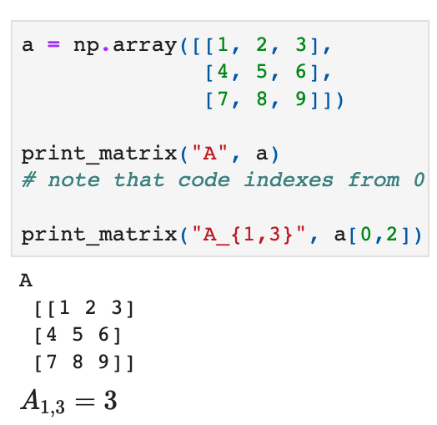
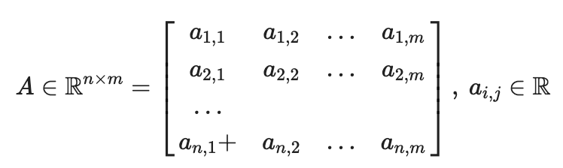
Intro to matrix notation
We write matrices as a capital letter, e.g. A:
where each element of the matrix A is written as A_{i,j}, for the ith row and jth column.

Slide 43

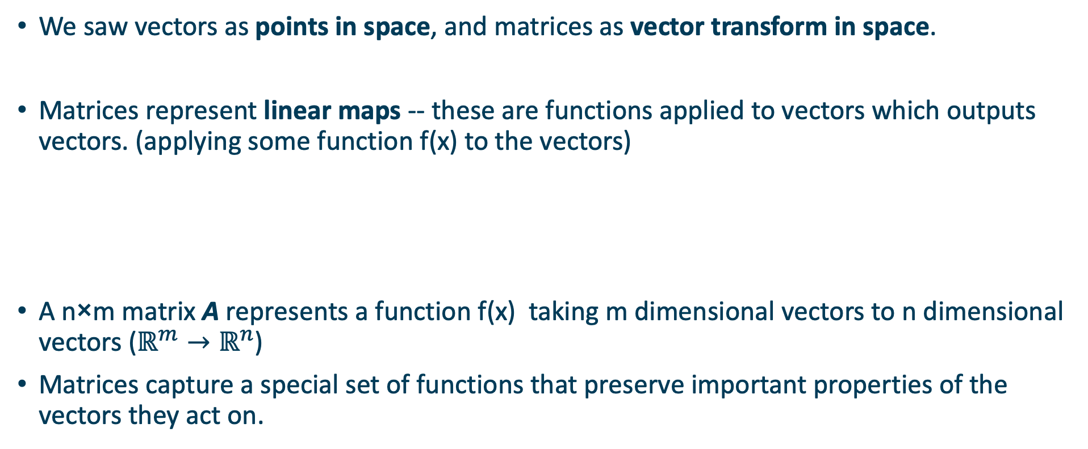
Matrices as maps
We saw vectors as points in space, and matrices as vector transform in space.
Matrices represent linear maps -- these are functions applied to vectors which outputs vectors. (applying some function f(x) to the vectors)
A n×m matrix A represents a function f(x) taking m dimensional vectors to n dimensional vectors ($ℝ^{m}→ℝ^{n}$)
Matrices capture a special set of functions that preserve important properties of the vectors they act on.

Slide 44
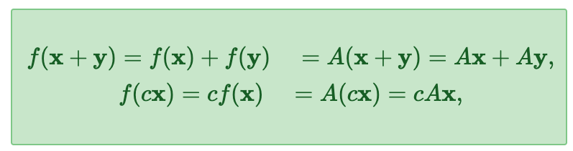
Linear maps
Linearity
the transform of the sum of two vectors is the same as the sum of the transform of two vectors
the transform of a scalar multiple of a vector is the same as the scalar multiple of the transform of a vector
Anything which is linear is easy. Anything which isn't linear is hard.

Slide 45
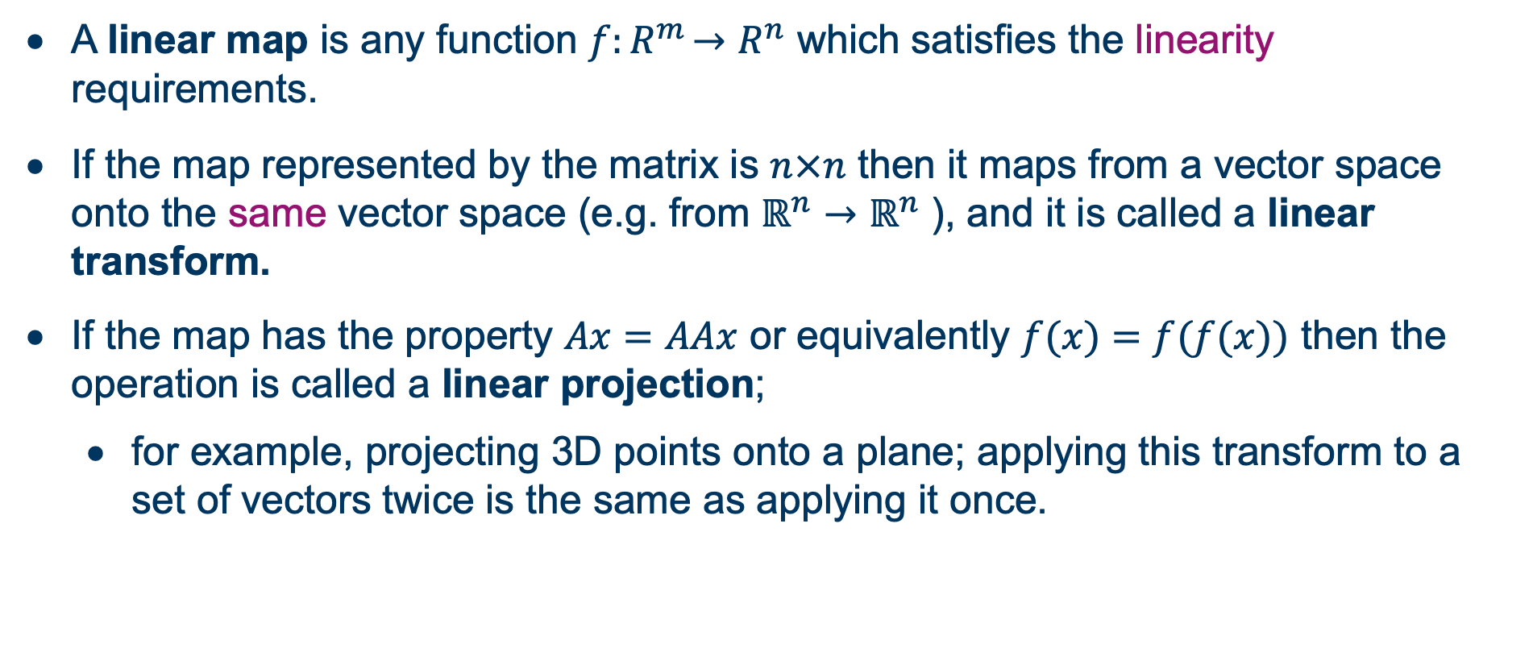
Transforms and projections
A linear map is any function $f{:R}^{m}→R^{n}$ which satisfies the linearity requirements.
If the map represented by the matrix is $n×n$ then it maps from a vector space onto the same vector space (e.g. from $ℝ^{n}→ℝ^{n}$ ), and it is called a linear transform.
If the map has the property $Ax=AAx$ or equivalently $f(x)=f(f(x))$ then the operation is called a linear projection;
for example, projecting 3D points onto a plane; applying this transform to a set of vectors twice is the same as applying it once.
Matrices represent linear maps or linear functions.

Slide 46
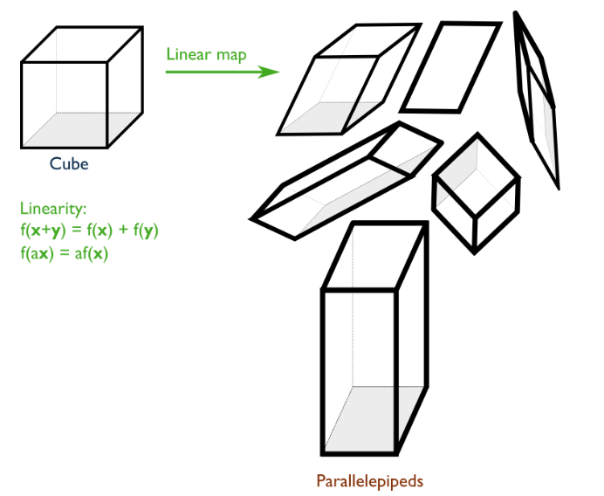
Geometric intuition (cube -> parallelepiped)
A matrix to transform a cube of vector space centered on the origin in one space to a parallelotope in another space, with the origin staying fixed.
A parallelotope is the generalisation of a parallelogram
A parallelogram is a 2-parallelotope
A parallelepiped is a 3-parallelotope
Matrix could possibly transform a cube (3D) into a 2-parallelotope
parallelotope

Slide 47
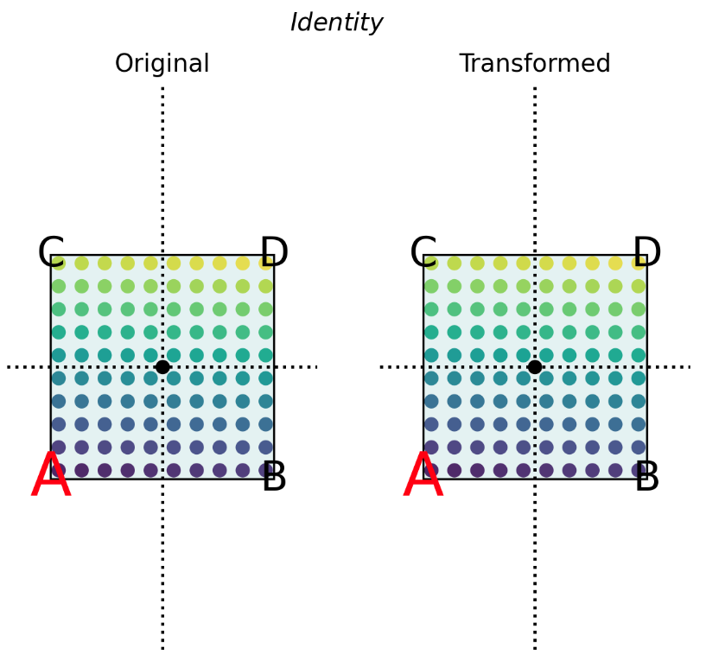
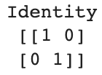

Examples - effect of linear transforms
linear transforms (linear maps ${A ∈ℝ}^{2×2}$: $ℝ^{2}→ℝ^{2}$ ), on the 2D plane.
We forms the product $A$x, which "applies" the matrix to the vector x.

Slide 48



Examples - effect of linear transforms
linear transforms (linear maps ${A ∈ℝ}^{2×2}$: $ℝ^{2}→ℝ^{2}$ ), on the 2D plane.
We forms the product $A$x, which "applies" the matrix to the vector x.

Slide 49


Examples - effect of linear transforms
linear transforms (linear maps ${A ∈ℝ}^{2×2}$: $ℝ^{2}→ℝ^{2}$ ), on the 2D plane.
We forms the product $A$x, which "applies" the matrix to the vector x.

Slide 50


Examples - effect of linear transforms
linear transforms (linear maps ${A ∈ℝ}^{2×2}$: $ℝ^{2}→ℝ^{2}$ ), on the 2D plane.
We forms the product $A$x, which "applies" the matrix to the vector x.
Notes:
first quartile – 2nd quartile
2nd quartile – 3rd quartile
3rd quartile – 4th quartile

Slide 51


Examples - effect of linear transforms
linear transforms (linear maps ${A ∈ℝ}^{2×2}$: $ℝ^{2}→ℝ^{2}$ ), on the 2D plane.
We forms the product $A$x, which "applies" the matrix to the vector x.
Notes:
first quartile – 2nd quartile
2nd quartile – 3rd quartile
3rd quartile – 4th quartile

Slide 52


Examples - effect of linear transforms
linear transforms (linear maps ${A ∈ℝ}^{2×2}$: $ℝ^{2}→ℝ^{2}$ ), on the 2D plane.
We forms the product $A$x, which "applies" the matrix to the vector x.
Notes:
See lecture notes for more examples and their codes

Slide 53

Matrix operations
The addition of matrices of equal size is simple elementwise addition.
Notes:
There is an algebra of matrices; this is linear algebra.

Slide 54

Matrix operations
The scalar multiplication cA is to multiply each element by c.
Notes:
There is an algebra of matrices; this is linear algebra.

Slide 55


Application to vectors
We can apply a matrix to a vector, equivalent to applying the function f(x) to x.
If $A$ is $ℝ^{n×m}$, and $x$ is $ℝ^{m}$, then this will map from an $m$ dimensional vector space to an $n$ dimensional vector space: $\left(ℝ^{n×m},ℝ^{m}\right)→ℝ^{n}$.
All application of a matrix to a vector does is form a weighted sum of the elements of the vector. This is a linear combination (equivalent to a "weighted sum") of the components.
Notes:
Let delve into the matrix applying.
We can apply a matrix to a vector. We write it as a product Ax, to mean the matrix A� applied to the vector x�. This is equivalent to applying the function f(x)�(�), where f is the corresponding function.

Slide 56

Application to vectors
In particular, we take each element of $x,x_{1},x_{2},…,x_{m}$, multiply it with the corresponding column of $A$, and sum these columns together.
Set $y=[0,0,0,…]=0^{n}$ (the $n$-dimensional zero vector)
For each column $1≤i≤m$ in $A$
$y=y+x_{i}A_{i}$. Note that $x_{i}A_{i}$ is scalar times vector, and has $n$ elements. $A_{i}$ here means the $i$ th column of $A$.

Slide 57

Let’s have a try
f(x)=Ax

Slide 58

Let’s have a try
f(x)=Ax
The traditional matrix multiplication approach (row-by-column)

Slide 59

Let’s have a try
f(x)=Ax
An alterative way :
Notes:
The second method emphasizes the concept of linear combinations of the columns of the matrix, while the traditional row-by-vector method emphasizes the dot product between rows of the matrix and the vector.
The second one is more intuitive way to understand linear map.

Slide 60

Application to vectors
We can use @ to form products of vectors and matrices in Numpy

Slide 61
Matrix multiplication
Matrix multiplication defines the product C=AB, where A,B,C are all matrices.
Matrix multiplication is defined such that if A represents linear transform f(x) and B represents linear transform g(x), then BAx=g(f(x))
Multiplying two matrices is equivalent to composing the linear functions they represent, and it results in a matrix which has that affect.
Note that the composition of linear maps is read right to left. To apply the transformation A, then B, we form the product BA, and so on.

Slide 62

Multiplication algorithm
If C=AB then
Multiplication is only defined for two matrices A,B if:
A is p×q and
B is q×r.
This gives rise to many important uses of matrices, for example, the product of a scaling matrix and a rotation matrix is a scale-and-rotate matrix.
Notes:
This gives rise to many important uses of matrices: for example, the product of a scaling matrix and a rotation matrix is a scale-and-rotate matrix.

Slide 63

Multiplication algorithm
Matrix multiplication is of course built in to NumPy
Matrix multiplication is applied by np.dot(a,b) or by the syntax a @ b

Slide 64
Time complexity of multiplication
Matrix multiplication has, in the general case, of time complexity O(pqr), or for multiplying two square matrices O(n³).
However, there are many special forms of matrices for which this complexity can be reduced, such as diagonal, triangular, sparse and banded matrices. (later)
There are some accelerated algorithms for general multiplication. The time complexity of all of them is >O(N²) but <O(N³).

Slide 65


Transposition
The transpose of a matrix A is written A^{T} and has the same elements, but with the rows and columns exchanged.
Two ways of using numpy
A.T
np.transpose(A)

Slide 66


Special matrix multiplication
outer product: the product of a Mx1 with a 1xN vector, which is an M×N matrix
inner product: the product of a 1xN with an Nx1 vector is a 1x1 matrix, which is a scalar

Slide 67
Matrix multiplication as composed maps
We saw vectors as points in space, and matrices as vector transform in space.
Multiplication is composition: If A represents f(x) and B represents g(x), then the product BA represents g(f(x)).
BAx=B(Ax) means do A to x, then do B to the result
Notes:
We saw vectors as points in space, and matrices as vector transform in space.

Slide 68


Composed maps
nonuniform scaling
rotation
Notes:
We can visually verify that composition of matrices by multiplication is the composition of their effects.

Slide 69


Composed maps
Nonuniform scaling matrix: scale_x
Rotation matrix: rot30

Slide 70


Composed maps
Nonuniform scaling matrix: scale_x
Rotation matrix: rot30

Slide 71
Concatenation of transforms
Many software operations take advantage of the definition of matrix multiplication as the composition of linear maps.
In a graphics processing pipeline, for example, all of the operations to position, scale and orient visible objects are represented as matrix transforms.
Multiple operations can be combined into one single matrix operation.

Slide 72



Commutativity and Transpose
The order of multiplication is important.
Matrix multiplication does not commute
Transpose order switching
It is also true that
Notes:
but this is less often useful.

Slide 73


An example matrix for measuring spread: covariance matrices
mean vector: the geometric centroid of a set of vectors
variance: measures the spread of a dataset
In the multidimensional case: covariance
Notes:
In the multidimensional case, to get a useful measure of spread of a N×d data matrix we need to compute the covariance of every dimension with every other dimension. This is the average squared difference of each column of data from the average of every column.

Slide 74


An example matrix for measuring spread: covariance matrices
Generate data examples
500x5 matrix
Compute covariance using np.cov()
5x5 matrix

Slide 75

Covariance ellipses
For a 2-D dataset
mean vector: 1x2
Covariance matrix: 2x2
The mean vector captures the idea of "centre"
The covariance matrix captures the "spread" of a collection of points in a vector space.

Slide 76





Special matrix forms
Diagonal matrix
np.diag(x)
Identity matrix
np.eye(n)
Zero matrix
np.zeros()
Upper triangular
Lower triangular

Slide 77
Beyond this course
3blue1brown Linear Algebra series (strongly recommended)
Introduction to applied linear algebra by S. Boyd and L. Vandenberghe
Linear Algebra Done Right by Sheldon Axler (excellent introduction to the "pure math" side of linear algebra) ISBN-13: 978-0387982588
Coding the Matrix: Linear Algebra through Applications to Computer Science by Philip N Klein (top quality textbook on how linear algebra is implemented, all in Python) ISBN-13: 978-0615880990
Linear Algebra and Learning from Data Gilbert Strang, ISBN-13: 978-069219638-0, explains many detailed aspects of linear algebra and how they relate to data science.
The Matrix Cookbook by Kaare Brandt Petersen and Michael Syskind Pedersen. If you need to do a tricky calculation with matrices, this book will probably tell you how to do it.

Slide 78

Thank you Contact: Nicolas.Pugeault@Glasgow.ac.uk

